Slide 1
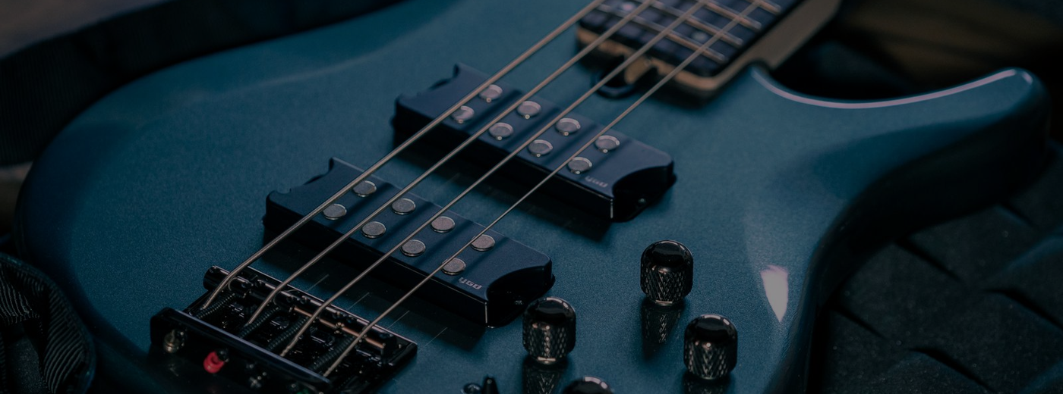
TIMBER CREEK
Americana, Folk Rock, and a Little Twang
Booking one sheet for taprooms and festivals around Raleigh
Contact: Travis Lockhart, (919) 555-0633

Slide 2
THE BAND
Four Piece, Raleigh Based
Member | Role
Travis Lockhart | Guitar and vocals
Jordan McDaniel | Bass
Brody Sands | Drums
Wes Coleman | Lead guitar
What you get
• Two sets of covers and a few originals
• Crowd friendly mix, Americana to classic rock
• Self contained, own instruments and backline
• Volume kept neighborly until 9 when asked
• Reliable load in, clean break down
Timber Creek booking one sheet
Timber Creek

Slide 3
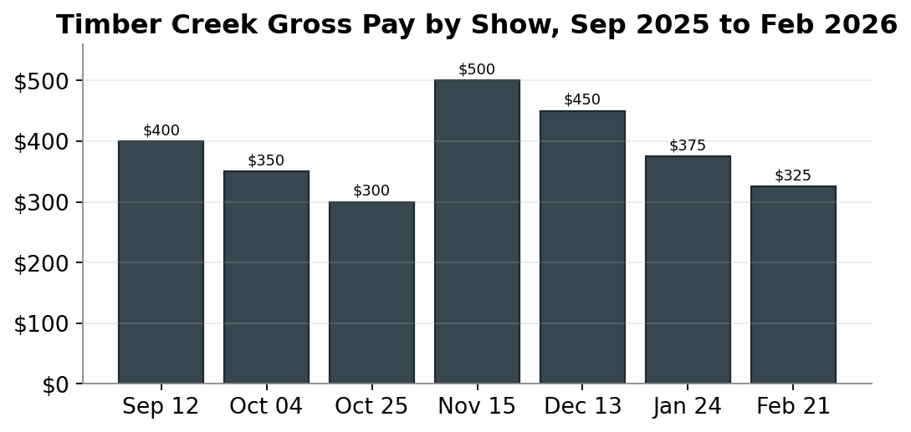
TRACK RECORD
Recent Shows
Date | Venue
Sep 2025 | Trophy Brewing Company
Oct 2025 | Lonerider Brewing Station
Oct 2025 | Neuse River Brewing
Nov 2025 | The Pour House Music Hall
Dec 2025 | Trophy Brewing on Maywood
Jan 2026 | Raleigh Beer Garden
Feb 2026 | Lynnwood Brewing Concern
Timber Creek booking one sheet
Timber Creek

Slide 4
SET LIST
A Taste of the Night
Set one | Set two | Encore
Take It Easy | Cover Me Up | The Weight
24 Frames | Thirteen Silver Dollars | Live and Die
Something More Than Free | Simple Man
Use Me | Ramble On
Cant You See | Stay a Little Longer
Head Full of Doubt | Wagon Wheel
Next date: Trophy Brewing Company, October 17, 2026, 8 PM. Booking and rates: Travis Lockhart, (919) 555-0633.
Timber Creek booking one sheet
Timber Creek

